Slide 1
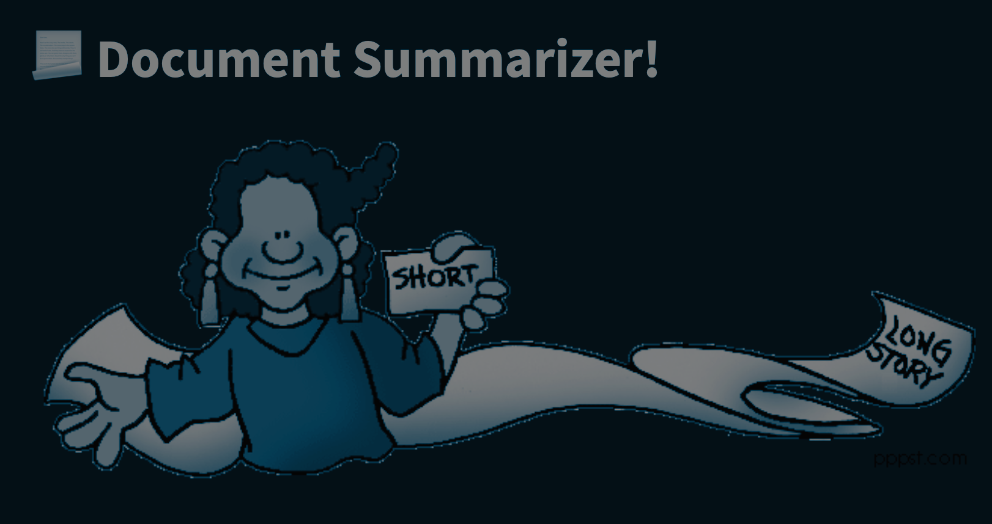

Document Summarizer
A report by Kruti
Date: 19/05/2023

Slide 2
Agenda
Introduction
Text Summarization
Model
ETL Pipeline
Demo
Future Expansion
Q&A

Slide 3
Introduction
Train model.
ETL Pipeline.
Streamlit app:
Get real time summary of texts and docs.
Get latest News summary of your choice.

Slide 4
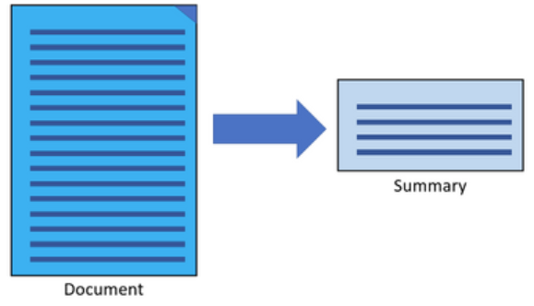
What is Text Summarization?
Text Summarization is the process of shortening a set of data computationally, to create a subset that represents the most important or relevant information within the original content.

Slide 5
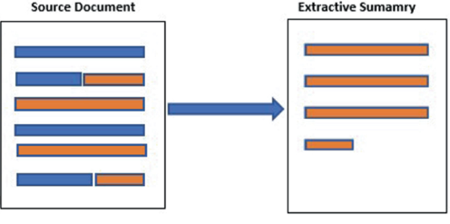
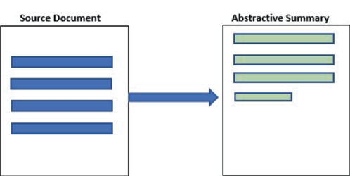
Types of Summarization
Extractive Text Summarization
Abstractive Text Summarization
Traditional method summary contains exact sentences from the original text data.
Advanced method summary, are generated by the model, not just extracted from the original text data

Slide 6
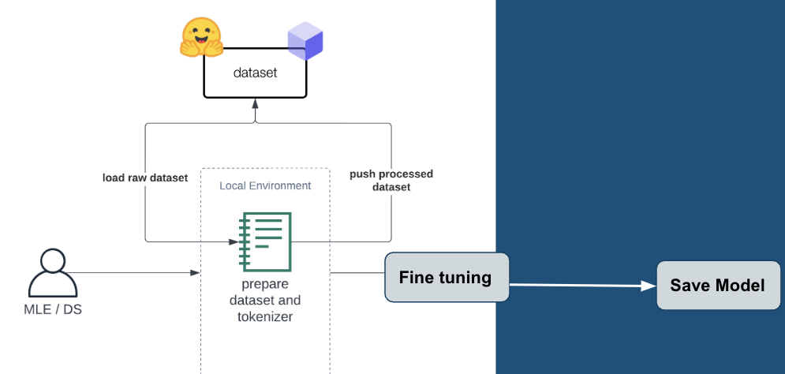
Pegasus
Pegasus is a pre trained transformer-based model.
Specializing in abstractive text summarization tasks. Generate summaries that capture the main ideas and key details of the input text.
Dataset: Hugging Face - CNN news mails
Model: Pegasus pretrain model fine tuned it
Save: save the model locally.

Slide 7
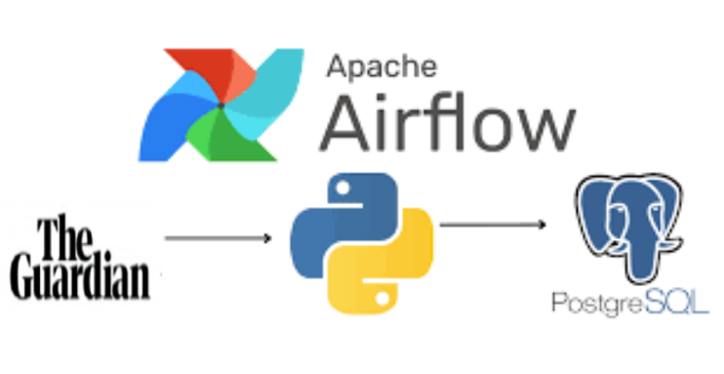
ETL Pipeline
Extract
Transform
Load

Slide 8
Airflow
Airflow is an open-source platform used for orchestrating and scheduling complex workflows and data pipelines. It allows users to define, schedule, and monitor workflows as directed acyclic graphs (DAGs).
A DAG (Directed Acyclic Graph) is a way to represent the flow of tasks. Think of it like a flowchart, where tasks are represented as boxes, and arrows show the order in which they should be executed.

Slide 9
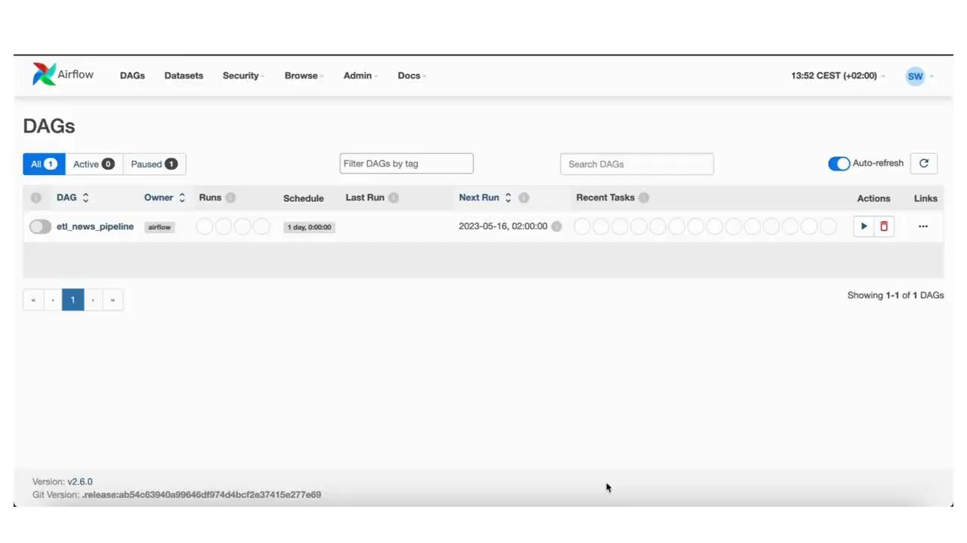
Airflow

Slide 10
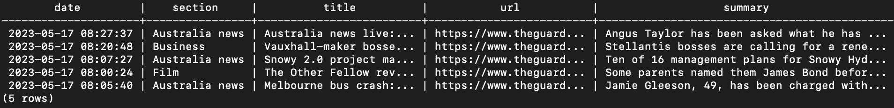
Postgres Table

Slide 11
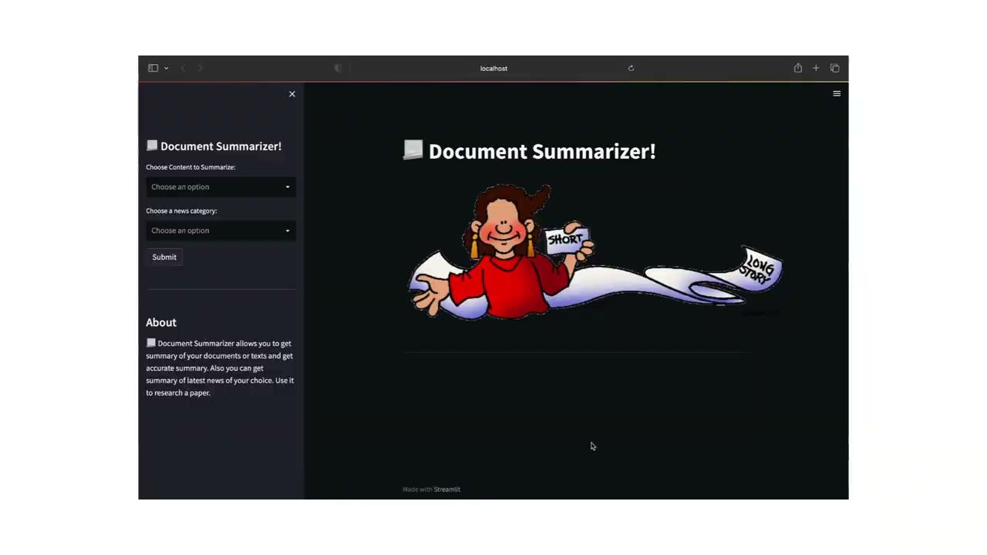
Demo

Slide 12
Future Expansion
Multilingual Support:
Extend the system to provide summaries and news in multiple languages.
Audio and Video Summarization.
Extend the system to support summarization of audio and video content.
Sentiment analysis:
To enhance the summarization process and provide additional insights about the content.

Slide 13
Thank You

